Slide 2
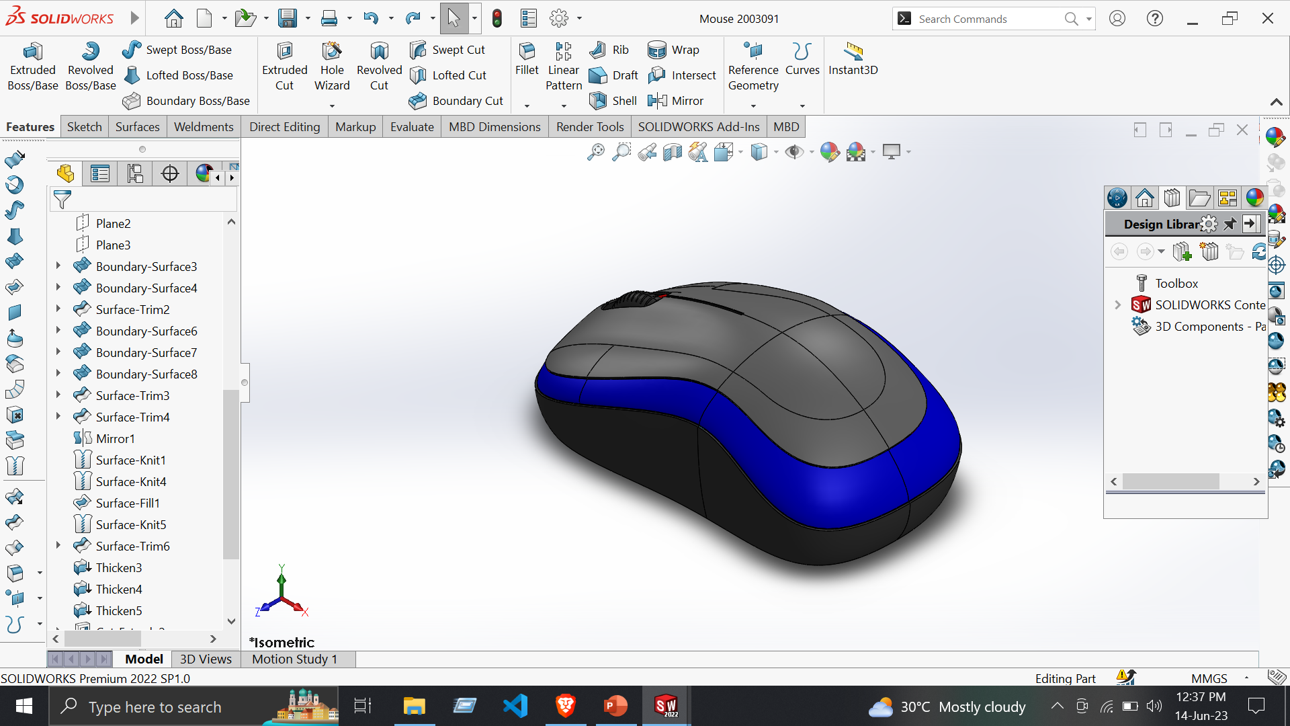
1. Mouse
Tools:
Line
Circle
Spline
Smart Dimensions
Covert Entities
Trim Entities
Surface:
Extrude surface
Boundary surface
Filled surface
Trim Surface
Knit Surface
Thicken
Features:
Extruded Cut
Fillet
Circular Pattern
Mirror

Slide 3
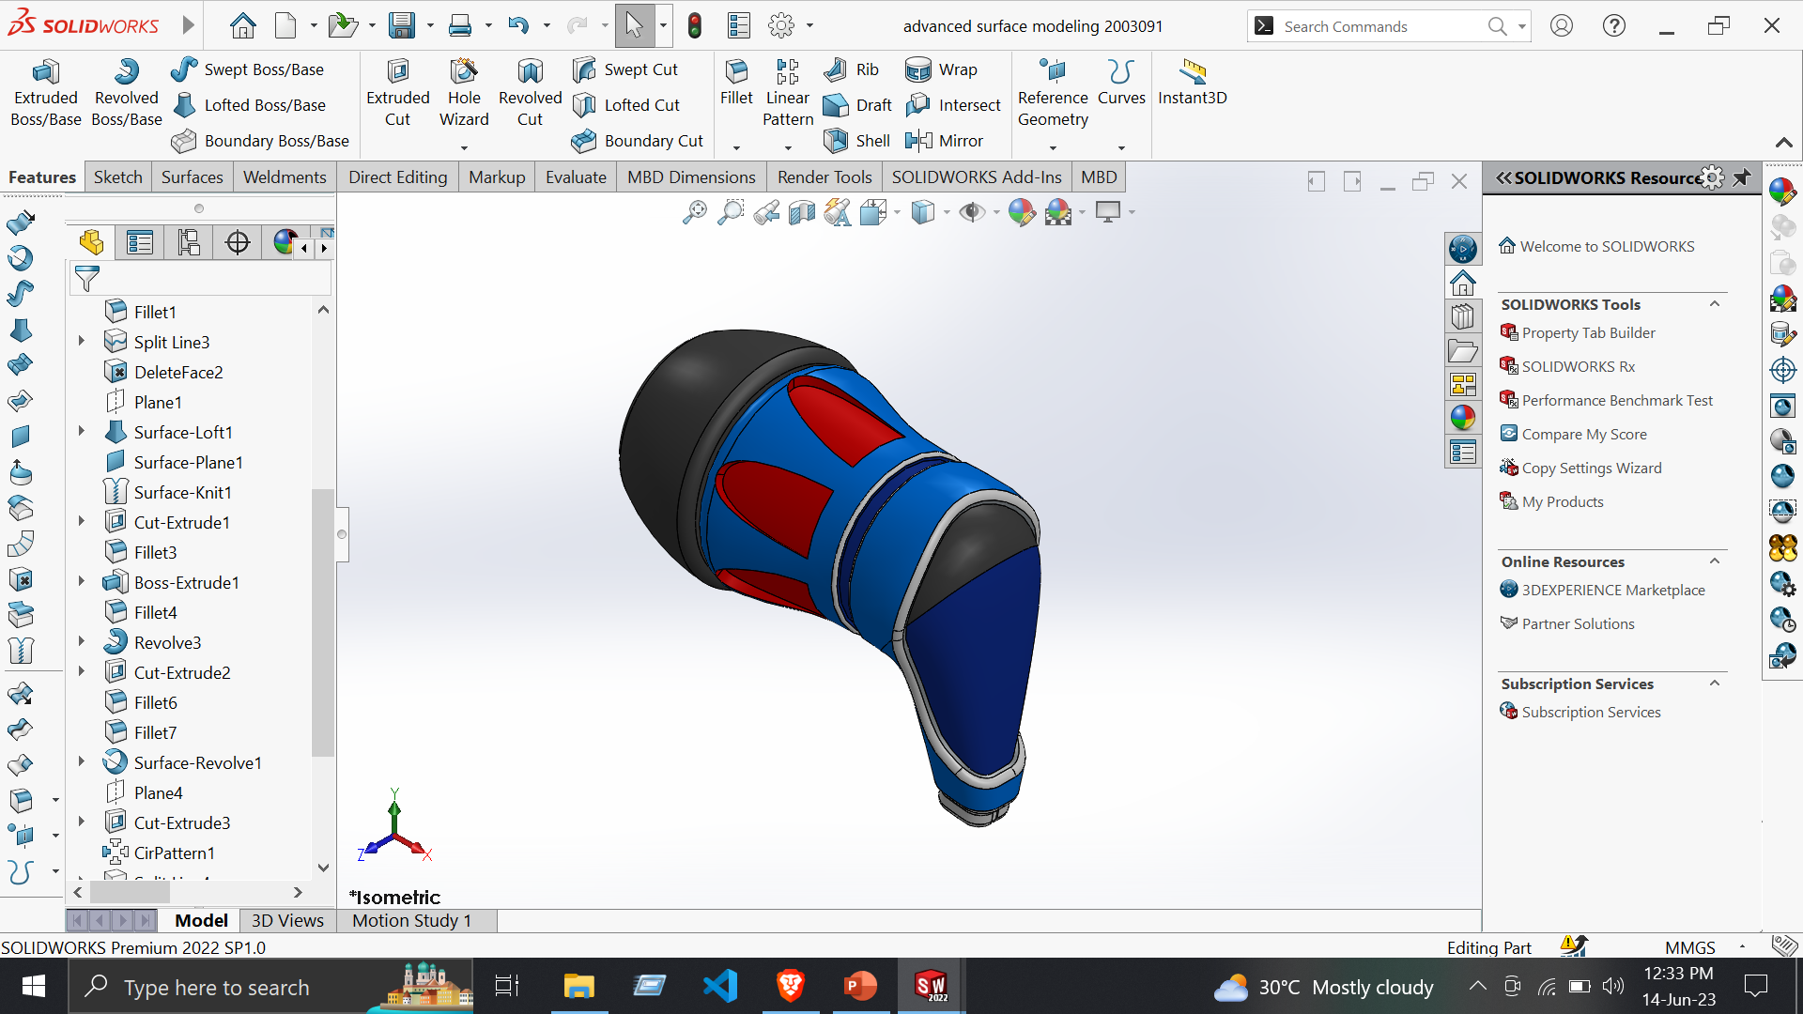
2. Advanced Surface Modeling
Tools:
Line
Circle
Rectangle
Smart Dimensions
Covert Entities
Trim Entities
Surface:
Extrude surface
Boundary surface
Filled surface
Trim Surface
Knit Surface
Thicken Cut
Delete Face
Revolved Surface
Features:
Extruded Boss/Base
Fillet
Shell
Revolved Cut
Reference Geometry

Slide 4
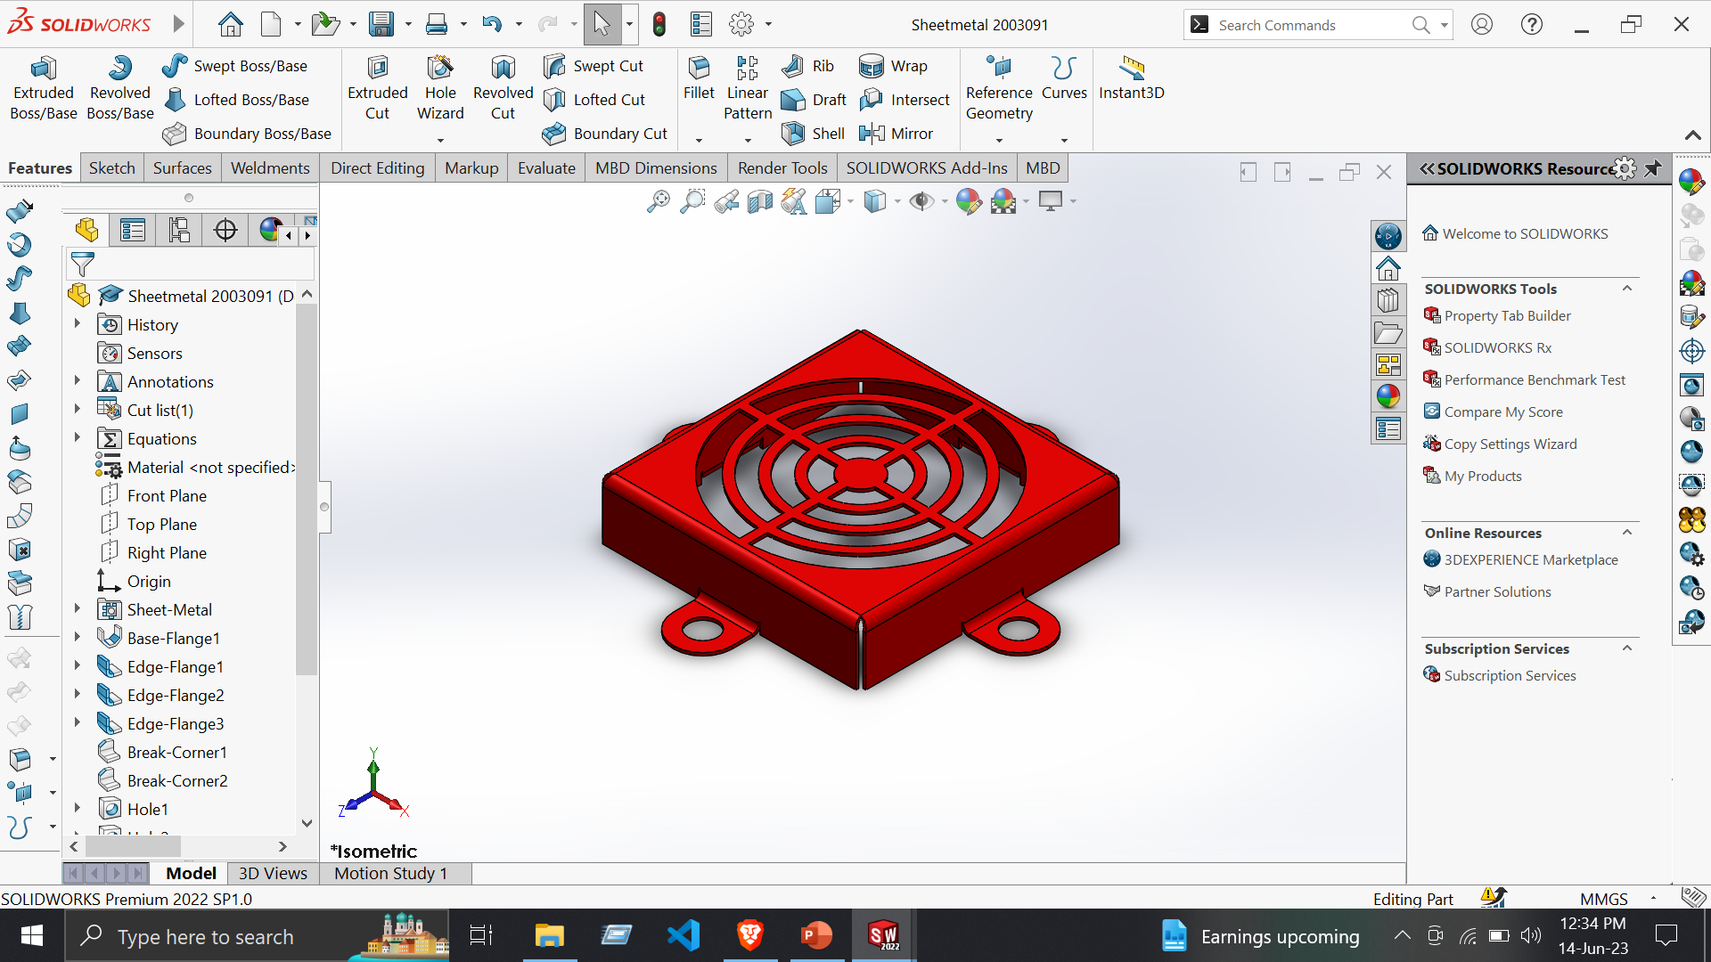
3. Vent
Tools:
Line
Circle
Rectangle
Smart Dimensions
Features:
Mirror
Hole
Fillet
Extruded Cut
Sheet Metal:
Base Flange
Edge Flange
Break Corner
Vent
Hole
Flat Pattern

Slide 5
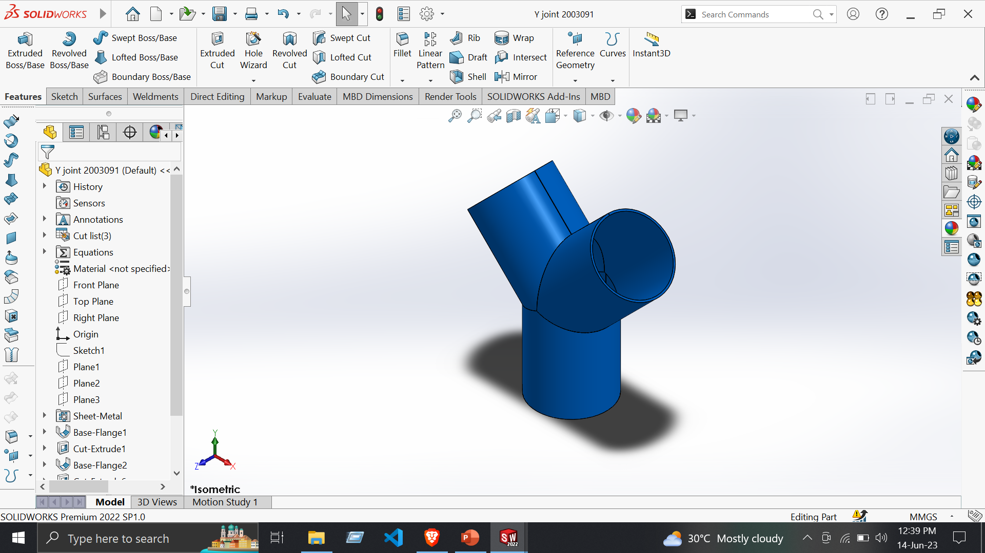
4. Y Joint
Tools:
Line
Circle
Spline
Smart Dimensions
Features:
Extruded Cut
Sheet Metal:
Base Flange
Flat Pattern
Base Bend

